Slide 1
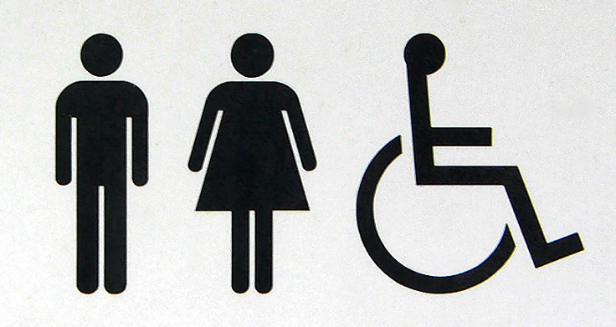
Gotta GO! Campaign Ottawa Public Toilet Map
Source: www.ottawapublictoilets.ca
By: Sarah Good

Slide 2
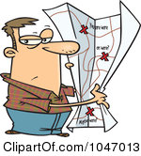
Purpose:
The purpose of this project is to create a map of the existing public toilets in Ottawa.
The data for the toilets location will be mapped in hard and digital copies and available for public use and input.
Maps will serve to aid both locals and tourists in locating public toilets.
May be used as a visual tool to demonstrate where need is the greatest and aid in consultation with city officials regarding proposed new public toilets.
Source: clipartof.com

Slide 3
Process:
Determine the information which should be present on the map. Example: address, hours, accessibility, changing facilities, parking, type of facility…
Obtain raw data from National Capital Commission (NCC) and the City of Ottawa for existing public toilets.
Transform data into same type of file and coordinate system. Online map is using KML files and WGS 1984 web coordinate system, and hard copy map uses shp files and NAD 83 coordinate system.
Find relevant information to include in map: waterbodies, major streets, transit hubs, and base map.
Create first draft, and alter according to feedback.
Fill in any missing information as it becomes available.

Slide 4
Creating a Hardcopy Map using ArcMap
ArcMap is an ESRI software which is used for a variety of geospatial functions
It is an extremely powerful tool which allows for the creation, manipulation, and statistical computing of geospatial information.
ArcMap primarily uses shapefiles (shp) which are a collection of files embedded with different information about the data. They must be contained within the same location in order to be opened in ArcMap.
A hardcopy map allows the creator to decide exactly what will and will not appear on the map. The data can be manipulated almost endlessly.
Hardcopy maps are easily distributed, and do not rely on an internet connecting for their use.

Slide 5
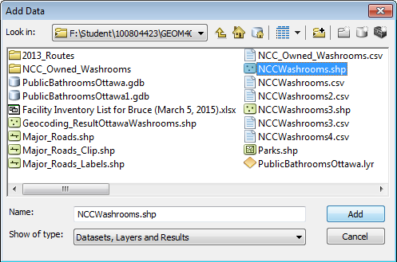
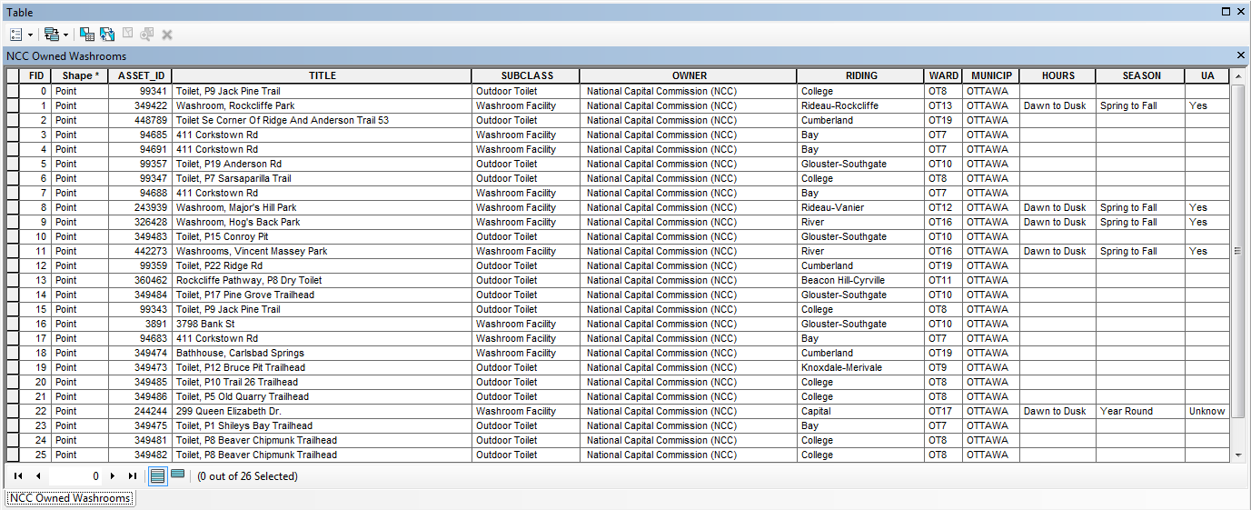
Original content of NCC owned toilets file
26 NCC owned toilets – in shapefile format
Projected to NAD 1983 MTM9
Without a basemap,
its just a bunch of points.

Slide 6
Creating a Basemap
In order to give the points a context, there must be some other locational information shown.
I acquired a file through the City of Ottawa website which made up the entire Ottawa region, and was separated into wards. This file was used to clips the other files.
A water file, also acquired through the City, was used to show the location of the Ottawa River, the Rideau Canal, and other bodies of water in the region.
Finally, the major roads file was found through the NCC’s thematic mapping data available through MADGIC (first floor Carleton Library).
It is important to make sure that there is enough information shown to allow the viewer to easily locate the general area, without putting so much information that the map becomes messy and difficult to read.

Slide 7
Basemap of Ottawa

Slide 8
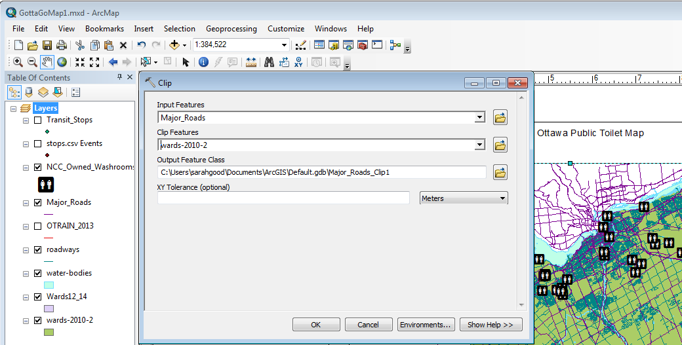
Clipping Files
Some of the shapefiles which were used for the final map extended over a larger area than the intended map, they were clipped to bit the borders of the City of Ottawa –
In this example, the file to be clipped was the Major_Roads file, and the clip boundaries used was from the file ‘wards-2010-2’ (representing the different wards in Ottawa

Slide 9
Labelling
When displaying labels, it is important to ensure that only the necessary information appears, and that it is clear and easy to read.
Key roads were selected and exported as a separate file. The roads labelled were then turned on only for the new condensed road file.

Slide 10
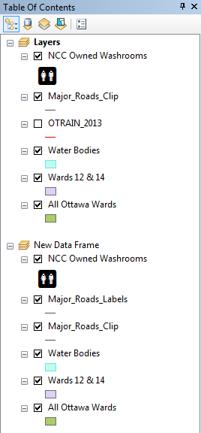

Slide 11
Creating an Digital Map using Google’s My Maps
Digital maps are great because they are accessibly to anyone with an internet connection. In fact, they can often be downloaded and viewed offline as well.
Goggle’s My Maps allows file to be imported in 3 formats: csv, xlsx, and KML.
Locations can be determined using either latitude and longitude coordinates or addresses.
Digital maps can easily be updated, and thus can be kept up to date as new information becomes available.
Digital maps are usually not as aesthetically pleasing and there is little control over what appears on the basemap, and limited control over symbolization.
There are types of digital maps which allow the creator to have more control, but they usually require a server and an administrator to keep the data updated. This can become an expensive endeavour compared to the available webmaps provided through Google, Bing Maps, or Open Maps.

Slide 12
Creating an Online Map using Original City of Ottawa file – csv format
This file only contains the location as an address. It cannot, therefore by loaded directly into ArcMap.
Using Google’s My Maps I am able to geolocate the points with only the addresses.

Slide 13
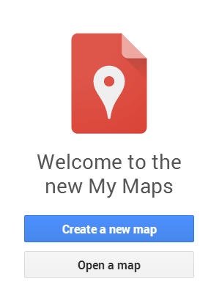
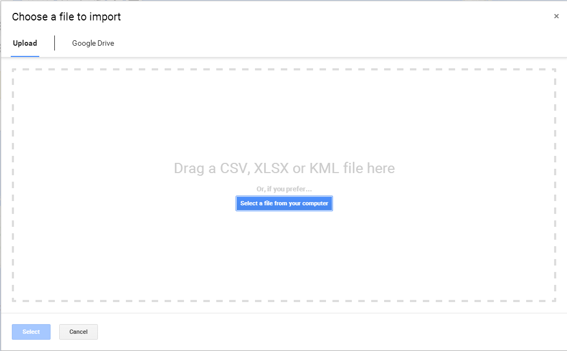
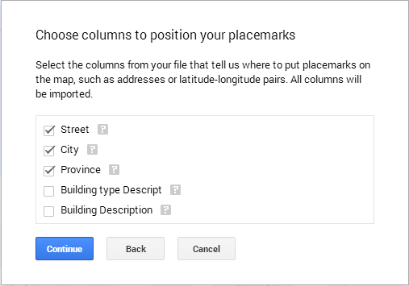
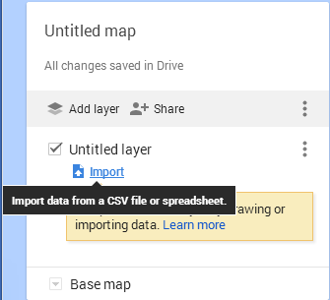
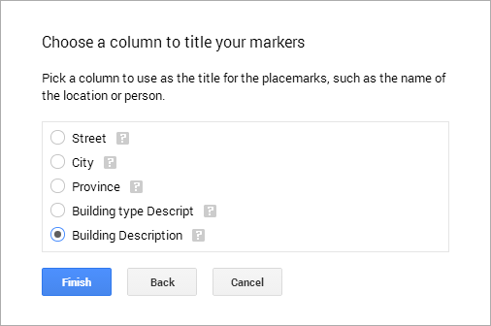
Geolocating bathroom location from addressed using Google’s – My Maps
Step 1: Go to https://www.google.com/mymaps
Step 2: Create New Map
Step 3: Add a layer, and import a file to populate it with
Step 4: Select the file, choose location columns, chose title column, and finish

Slide 14
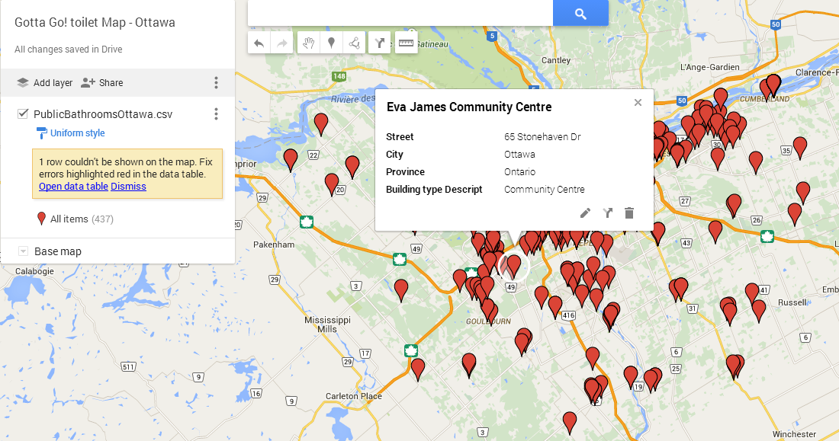
Preliminary Online Map
By click on a marker, a pop-up appears showing the information contained in the columns of the csv file.

Slide 15
Adding the NCC file using Latitude and Longitude
Because the locational information in a shapefile in embedded within the files, they cannot be easily imported into Google My Maps.
We must add in columns for the longitude and latitude of each point, by using the “Calculate Geometry” tool in ArcMap.
In order for the proper coordinates to appear in the longitude and latitude columns, we must ensure the projects match.
After a few failed attempts, the NCC bathrooms were added to the map in the right location!

Slide 16
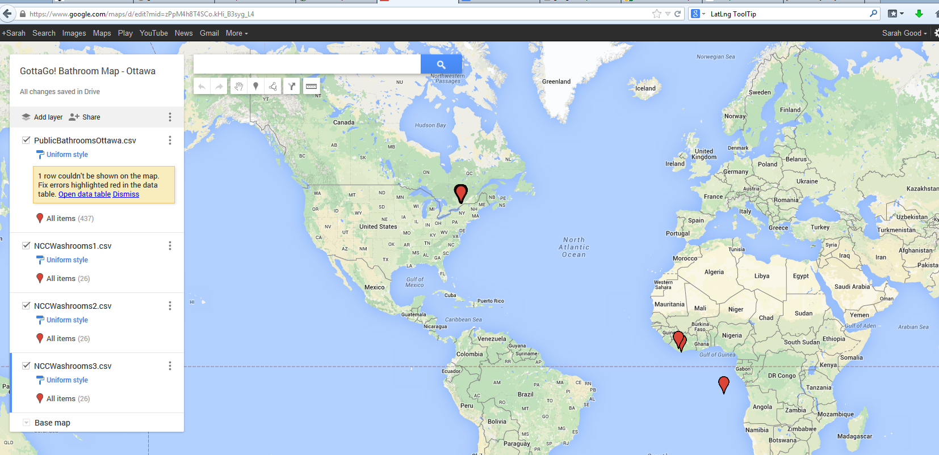
Projections Going Wrong ☹
This is the wrong projection, clearly.
Latitude | Longitude
5.66783 | -8.4397
5.69273 | -8.4255
5.68348 | -8.4102
5.67391 | -8.4452
5.6738 | -8.4458

Slide 17
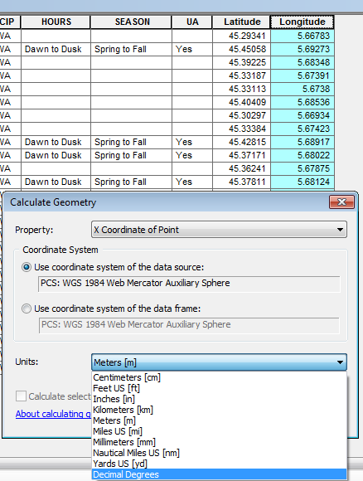
Projections Going Right ☺
Right Wrong
After a bit of research I found the right coordinate system, and was able to figure out how to project my file from NAD 83 to WGS 1984 Web Mercator.

Slide 18
Success!!!

Slide 19
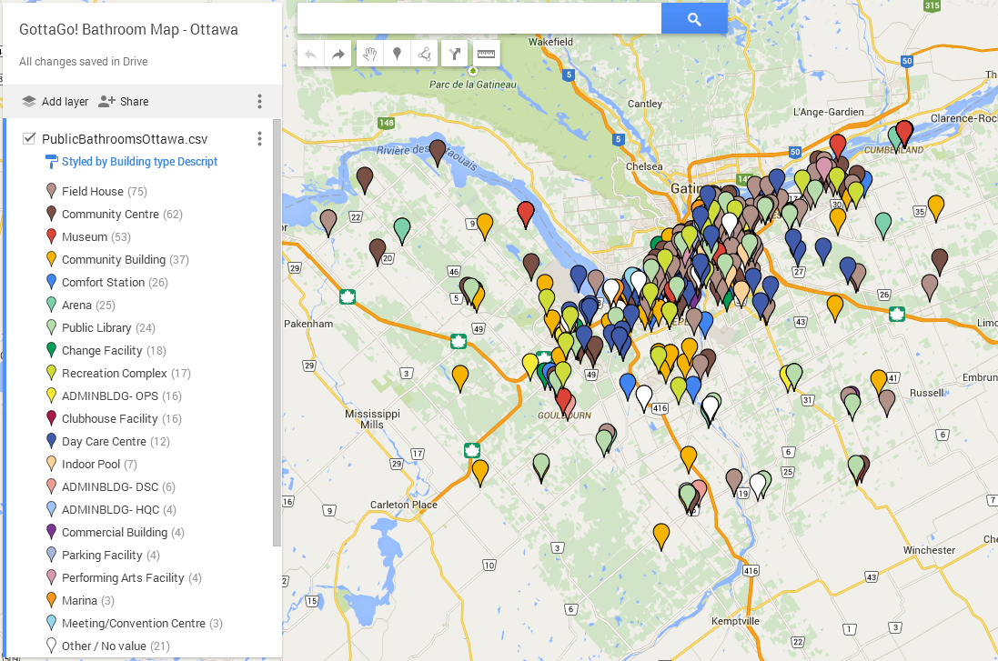
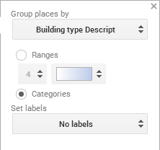
Symbolization by Building Type Description
So much going on!!!

Slide 20
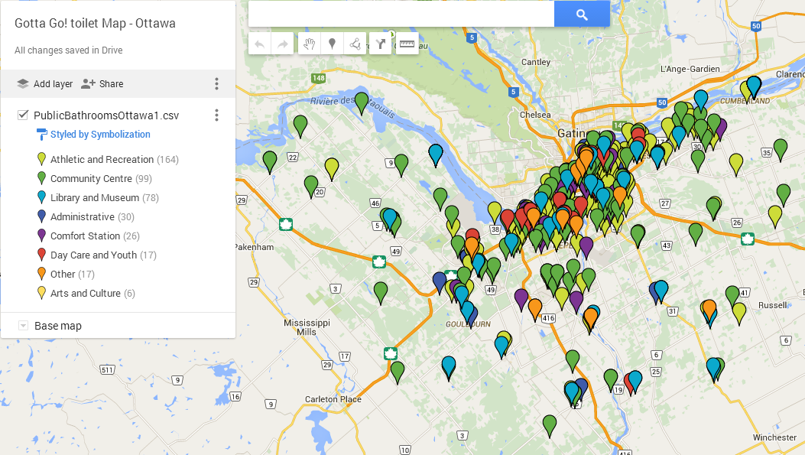
Refining Symbolization
In the map shown on the previous slide, each point is grouped by the “Building Type” which was given in the original file. There were 20, which is WAY too many.!
In order to create smaller groups, a new column was added to the csv file using Excel. Each category was manually assigned based of my own discretion. These were reduced from 20 groups to 8, and could (should) be reduce further for simplicity.

Slide 21
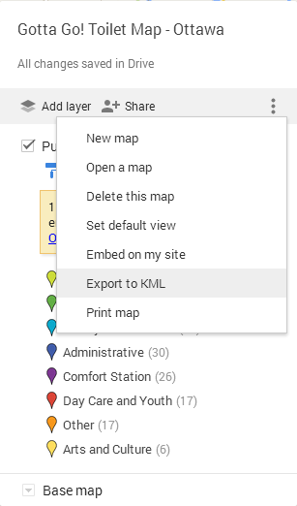
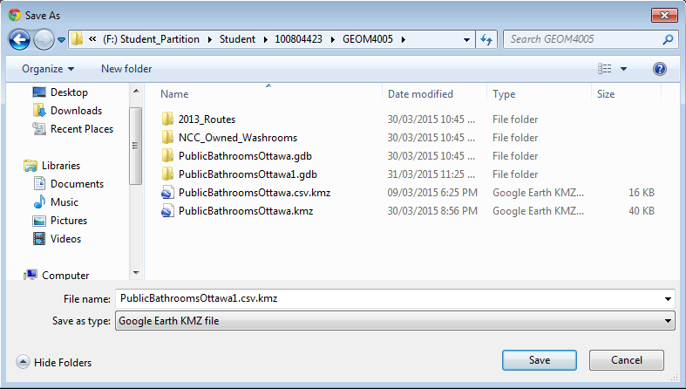
Exporting/ Saving the KML file
Now that we have the NCC files in My Maps, we still need to import the City of Ottawa files in ArcMap for editing.
To do this, click on the 3 vertical dots and select ‘Export to KML’
It gives the option of selecting the entire map or a single layer. In this case only the ‘PublicBathroomsOttawa’ file was selected.
Save into the proper folder so that it can be easily found.
Notice: the file will have the extension .kmz instead of .KML

Slide 22
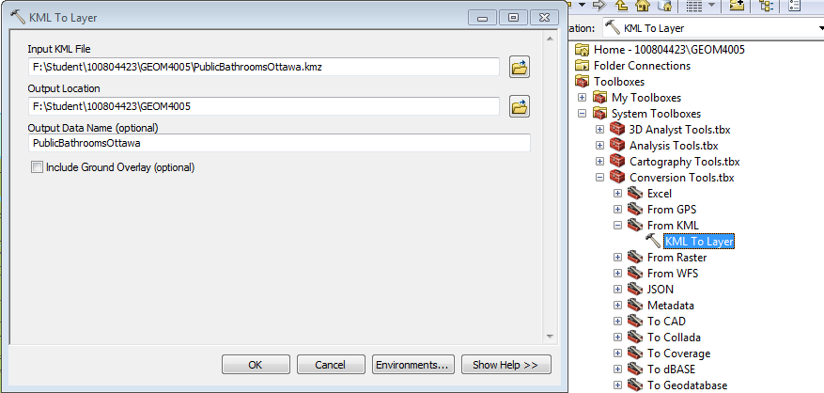
Converting KML file to shp
Using ArcMap, ensure that the toolbox extension for ‘Conversion Tools’ is selected.
Step 1: Find that toolbox, go to ‘From KML’, then select ‘KML to Layer’
Step 2: Select the Input KML File: ‘PublicBathroomsOttawa.kmz
Step 3: Select Output location (should be where all of the other files are saved.)
Name your data, and click ‘OK’

Slide 23
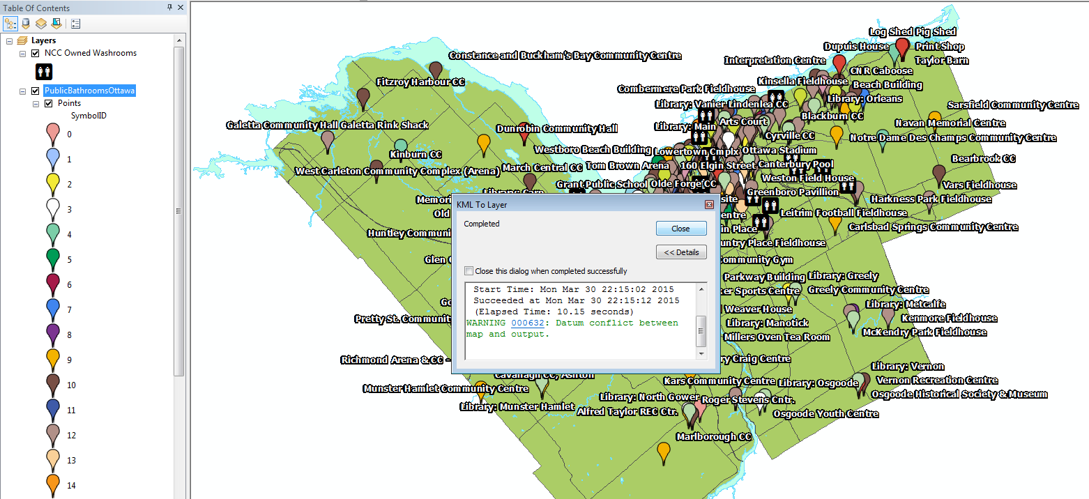
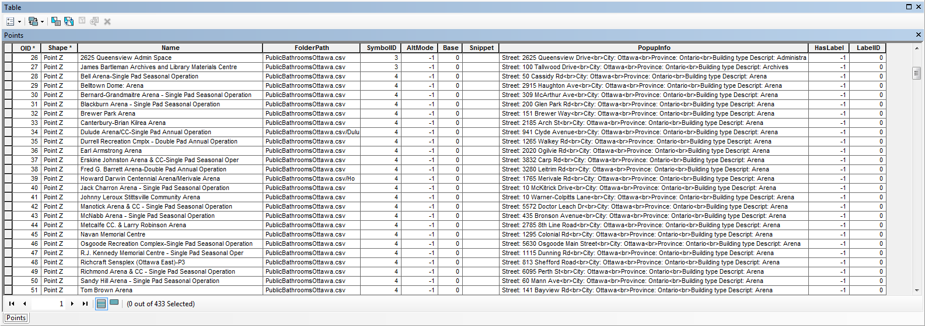
Adding Newly Converted Files to the Map

Slide 24
KML files now in shp file format, being projected to NAD 1983 MTM 9

Slide 25
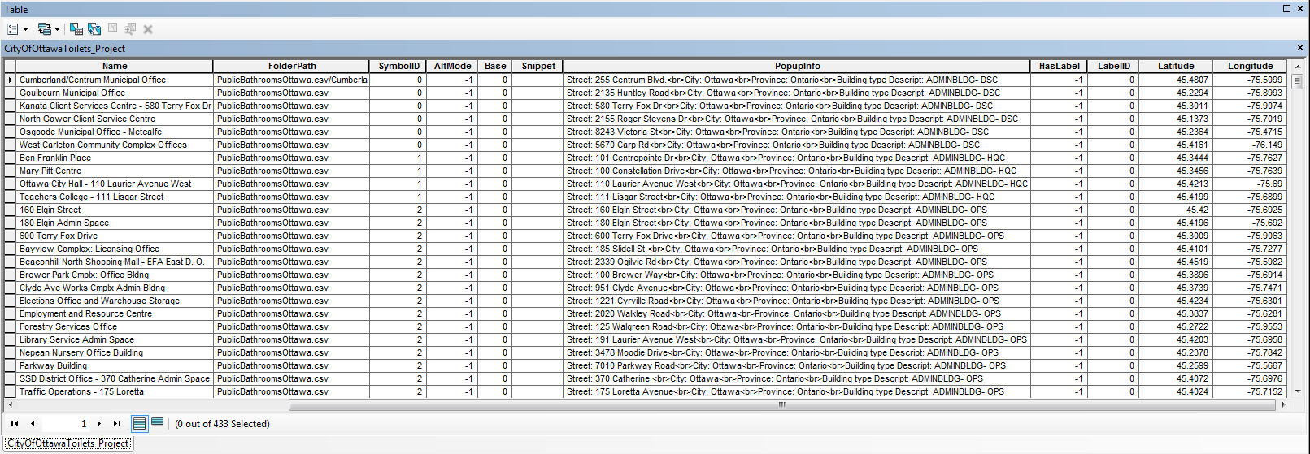
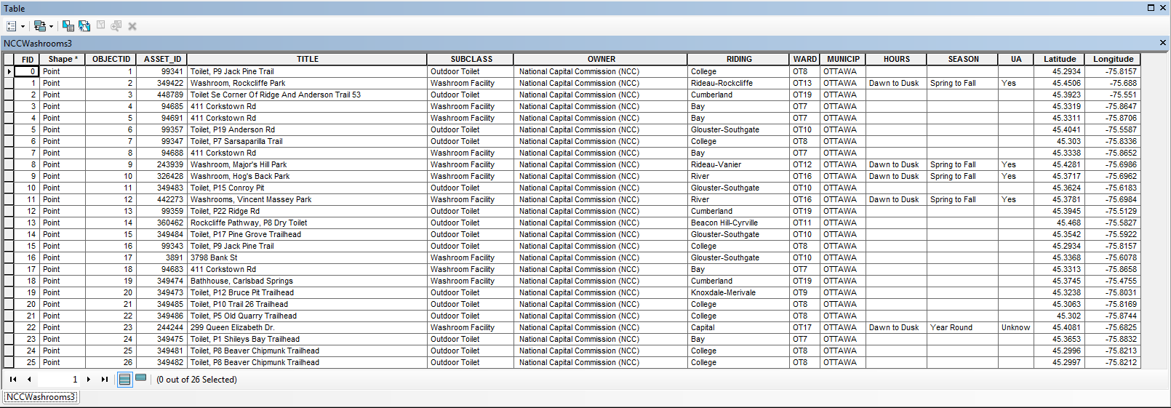
NCC and City of Ottawa Files in Same Projection with Calculated Latitude and Longitude

Slide 26
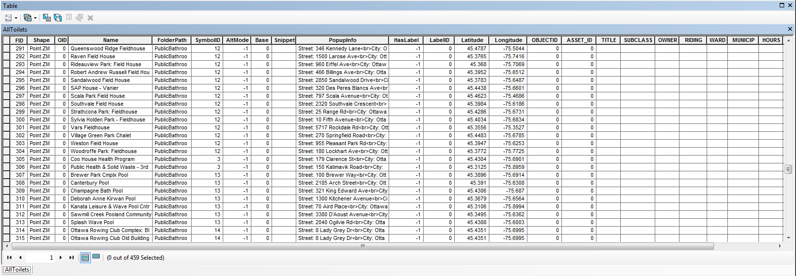
Merge both files into one

Slide 27
Edit AllToilets.dbf in Excel, Remove Unnecessary Columns
Remove OID_, FolderPath, AltMode, Base, Snippet, HasLabel, LabelID, and Riding
Delete Day Cares, Insert Addresses from original City of Ottawa files

Slide 28
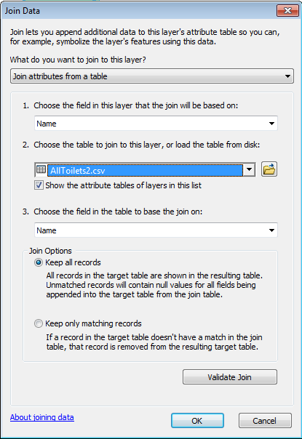
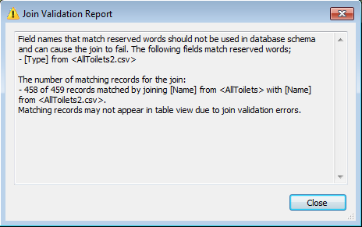
Join New Data
Join updated csv file to shp file

Slide 30
CSV file for Combined NCC and City of Ottawa Toilets – Ready for Import into Google’s My Maps

Slide 31
GottaGo! Ottawa Map – on Google My Maps

Slide 32
Next Steps:
Retrieve any missing data and complete the desire fields: address, hours, accessibility, changing facilities, parking, type of facility
Create easy to follow procedure for updating and publishing digital map through Google’s My Maps or Google Earth.
Complete hardcopy map with proper symbolization, legend, and table detailing the information shown above.
Publish both hardcopy and digital maps for public use!
Link to My Maps current digital copy: https://www.google.com/maps/d/edit?mid=z0wEUSMWjzaw.kXRLX0BH6tQU

Slide 33
Contacts:
Gotta Go! Campaign Organizers:
Joan Kuyek joankuyek@sympatico.ca
Bessa Whitmore Elizabeth.Whitmore@carleton.ca
Eric McCabe eric.reddeer@gmail.com
Carleton Faculty Project Supervisor:
Trish Ballamingie PatriciaBallamingie@cunet.carleton.ca
Dan Patterson Dan.Patterson@carleton.ca
National Capital Commission Data:
Jocelyne Moncion jocelyne.moncion@ncc-ccn.ca
City of Ottawa Data:
Eva Walrond Eva.Walrond@ottawa.ca

Slide 34
Questions or Comments?
What do you think might be missing?
Do you think that this is a effective map?
Would you be likely to use either the hardcopy or digital map?

