Slide 1
GottaGo! Campaign
Presentation to the
Transit Commission
RE: City budget 2018

Slide 2
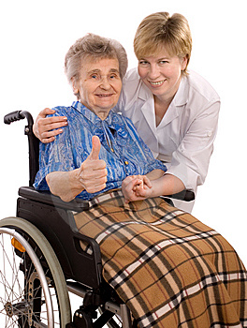
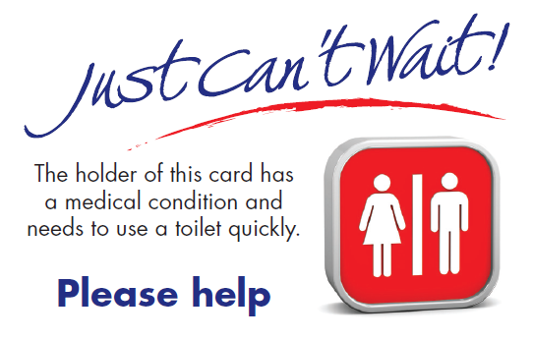
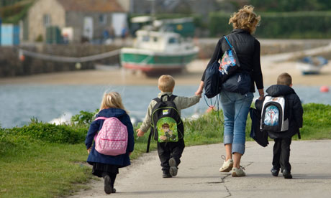
Open, accessible, public toilets are an issue for everyone

Slide 3
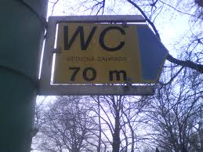
Make them easy to find

Slide 4
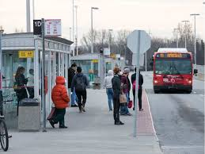
We need toilets at all major transit stops

Slide 5
There are no toilets at or near most Park & Ride lots. On most days, these lots are used by more than 7000 OC Transpo customers.

Slide 6
Request that the $40,000 in capital costs be allocated in 2018 for a pilot project:
* the installation of a dry composting toilet for public use
at the Eagleson Park and Ride.
* We are aware of at least one Canadian supplier that could provide the toilet

Slide 7
The Kazuba dry toilet from Atmosphare in Montreal

Slide 8
Waterless composting toilet

Slide 9
Public toilet availability is not only a human dignity issue and an indicator of civilization, it is a sound economic strategy.

