Slide 1
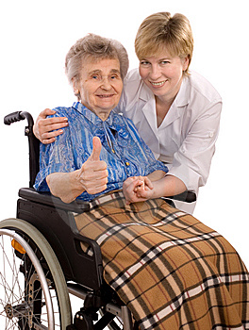
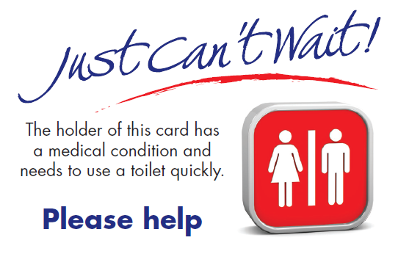
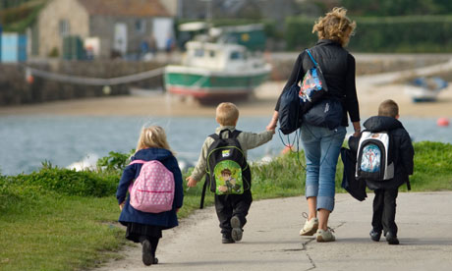
Open, accessible, public toilets are an issue for everyone

Slide 2
A lot of toilets could be available to the public in Ottawa, but are rarely open, hard to find and inadequately maintained.
Open seasonally or only during “programming hours”
As recreational programming cut, the availability of public toilets have also been cut.
Notes:
Walkability audits undertaken by the Pedestrian Safety Subcommittee of the Council on Aging and Ecology Ottawa indicate that the lack of accessible, open public toilets are a major impediment to active living for everyone.

Slide 3
Where to go??
Notes:
MacDonalds, coffee shops, etc. are often used as public toilets, but require a purchase.

Slide 4
We need toilets at all major transit nodes. The Confederation Line stations are an opportunity to do it right. 10,000 users/hour!
Notes:
Esp. in major nodes: Hurdman, Bayview

Slide 5
Our city does not provide an essential service
Lost business opportunities
Sanitation concerns
Recreational opportunities restricted
Health and social costs borne in quiet by individuals
Notes:
PSU McNair Scholars Online Journal, Volume 8, Issue 1, The Impact of Innovation: New Frontiers in Undergraduate Research, Article 5, 2014. “Go Before You Go: How Public Toilets Impact Public Transit Usage” by Kate M. Washington, Portland State University.

Slide 6
Other places
Japan and Korea lead the world in public toilet provision.
In many European cities like Oslo, London and Paris, public toilets are taken for granted.
Australia and New Zealand have great toilets and maps to find them.
New York and Washington DC include public toilets in their subway systems.
Notes:
in New York and Washington there were a number of closures of Subway washrooms after 9/11, but New York still has 69 toilets and Washington is adding modern toilets to their new Silver Line.

Slide 7
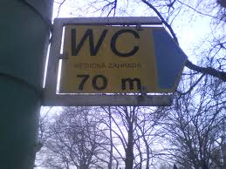
Make them easy to find

Slide 8
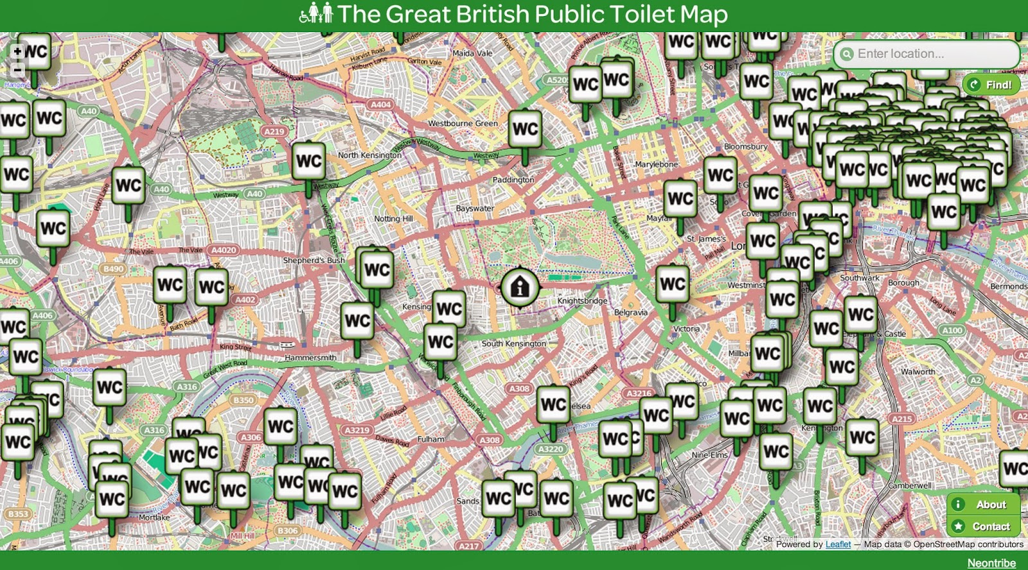
Notes:
London toilet app

Slide 9
Public toilets can be open, easy to find, accessible and safe
Modern design makes them secure and safe
Accessibility needs integrated in design
Reduced costs of operations
Opportunity to develop an Ottawa model
Notes:
Paris

Slide 10
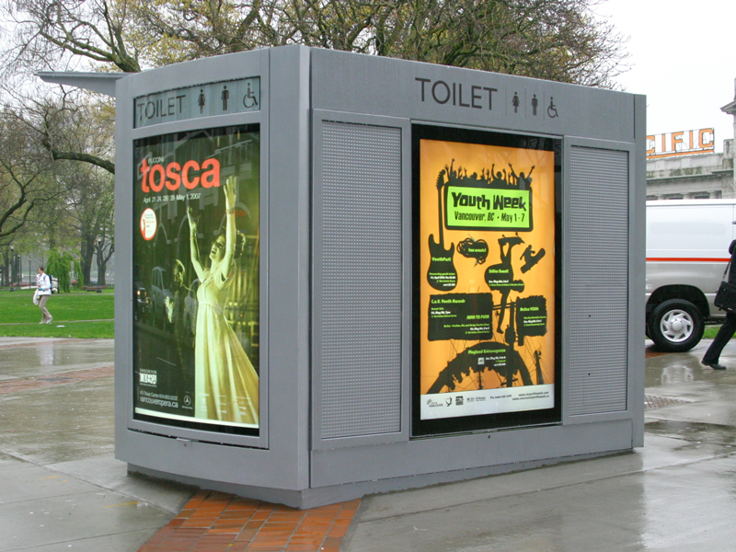
Design can be attractive, safe and economic
Vancouver
New Zealand
Notes:
New Zealand
Vancouver – hooked into city sewer system.
Advertising on exterior can generate revenue

Slide 11
Edmonton Whyte Avenue Restroom
Notes:
Design enhances safety – visible from outside

Slide 12
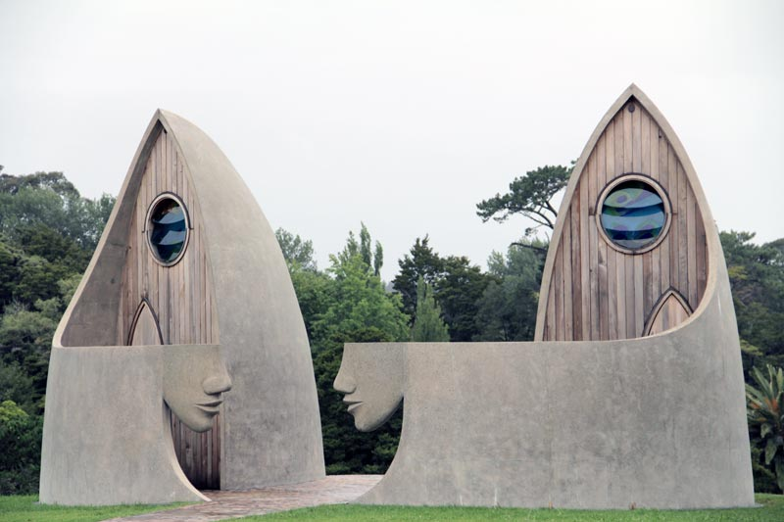
Matakana Public Toilets
Notes:
New Zealand – result of a design competition

Slide 13
Design to resist vandalism and for easy cleaning

Slide 14
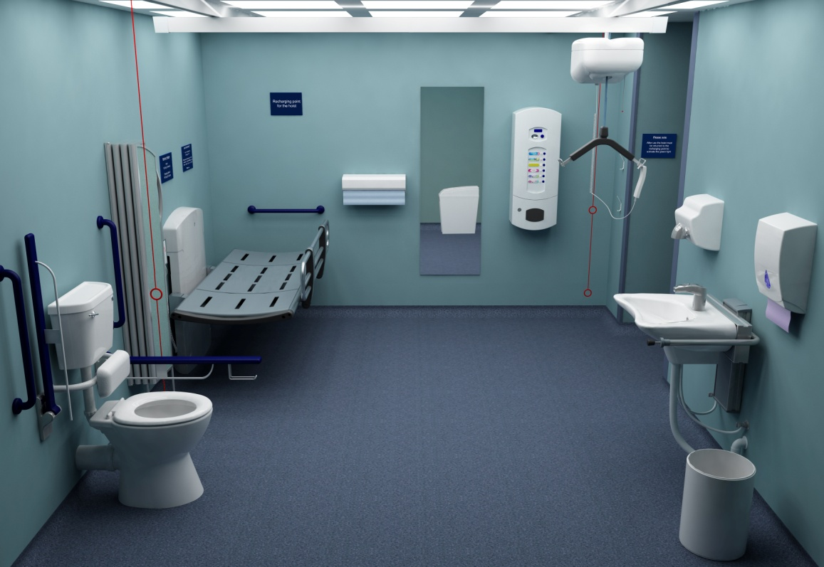
Adult “Changing Places” toilets http://pamis.org.uk/cms/files/publications/ChangingPlacesaPracticalGuide.pdf
Notes:
Scotland has 40 of these; Ottawa has none

Slide 15
Request to the Board of Health(1)
undertake an analysis of the benefits, program planning and regulatory framework necessary to establish such a network in Ottawa (particularly with regard to the needs of an aging population, pregnant women, families with small children, the 7000 identified sufferers of Crohns and Colitis in Ottawa, and of people with other disabilities, such as an enlarged prostate).

Slide 16
Request to the Board of Health (2)
Help us ensure that the resources are made available in the 2015-2018 City budget to meet new requirements regarding public toilet provision in the 2015 revisions to the Older Adult Plan.

Slide 17
“Public toilets represent society’s finest aspirations about responsible civil behaviour. A great city has great public toilets”
Notes:
Ray Bridgeman – Winnipeg architect
From article entitled “Human dignity on main street”)

